Slide 1

SAILES
An Interpretable AI Market Consultant
Schneider Electric | Hackathon Report

Slide 2



The Business Problem: Why?
The Context
The "Black Box" Challenge
Schneider Electric has millions of data points from sales opportunities, including Customer History, Product Mix, Competition, and Timing.
Traditional AI models don't explain their reasoning, which creates problems for:
•
Trust: Hard to trust predictions you don't understand.
We can predict outcomes, but we need to know *why*.
•
Action: Can't take corrective action if you don't know what matters.
•
Learning: Can't improve processes without understanding success patterns.

Slide 3





Our Goal: Answering The Three Key Questions
1. What will happen?
2. Why will it happen?
3. What can we change?
Predict the outcome of a sales opportunity (Win/Loss) based on all available data.
Explain the *reasons* behind the prediction, building trust and enabling learning.
Provide specific, actionable analysis on what could flip a predicted loss into a win.

Slide 4
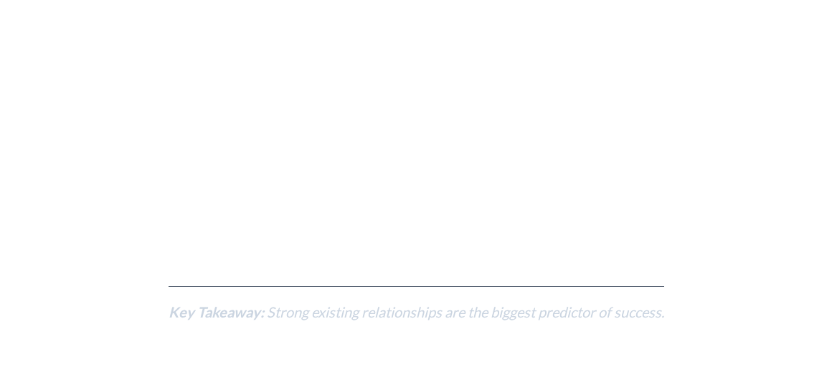




Layer 1: Global Insights
What factors matter most across all opportunities?
Customer Hit Rate: Historical success rate with the customer is the top predictor.
Interactions & Contracts: The level of engagement and existing business relationships.
Historical Sales: Whether we have successfully sold a specific product to them before.
Opportunity Novelty: Long-standing, stalled opportunities are significantly less likely to be successful.

Slide 5
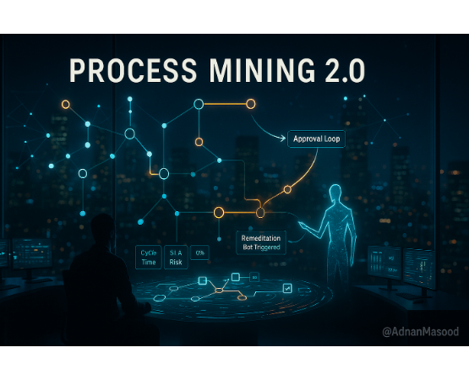
Layer 2: Local Explanations
Why did the model make this specific prediction?
Technique: Decision Path Analysis
The model finds the "tie-breakers" among its internal sub-models to reveal which trends were most important for a single prediction.
Example Explanation:
"This opportunity has a high probability of success because the customer has a 95% historical success rate and we've had 12 previous positive interactions with them."

Slide 6
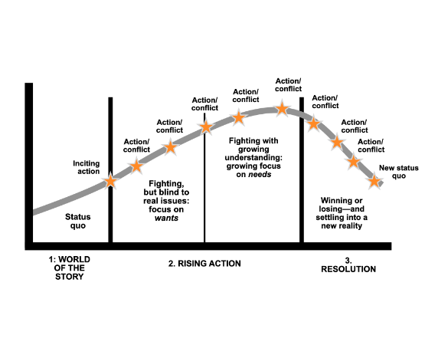
Layer 3: What-If Analysis
What would need to change to flip the prediction?
Technique: Counterfactual Generation
Given a "Loss" prediction, the VAE model finds the most similar plausible opportunity that would have resulted in a "Win."
It provides the minimal amount of feature changes possible to achieve this, making the advice actionable.
Business Impact:
This empowers sales teams by showing them the specific, high-leverage activities they can perform to help overturn a potential loss and prioritize their efforts.

Slide 7
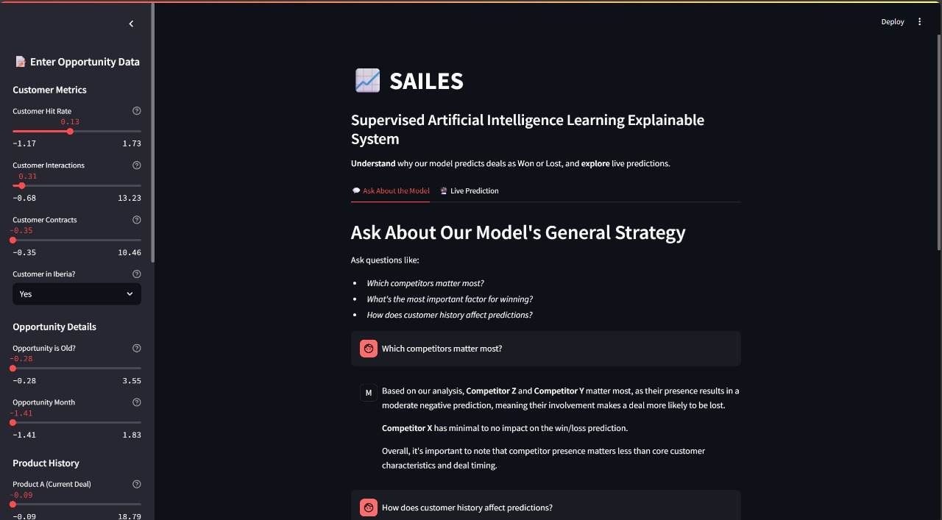
MVP
SAILES (Supervised Artificial Intelligence Learning Explainable Systems)

Slide 8
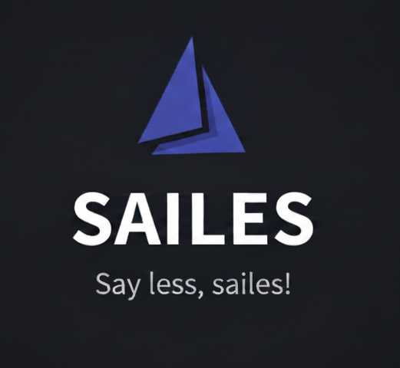

Slide 9
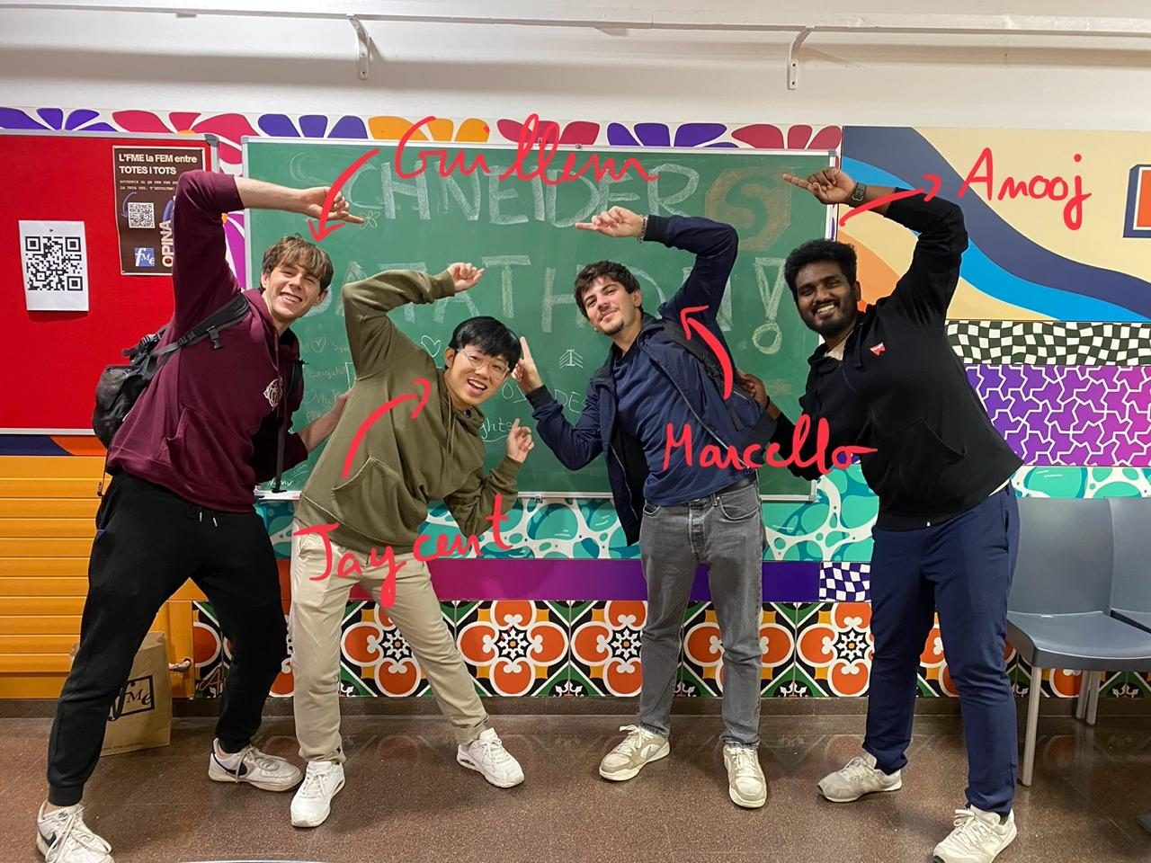
Questions?

